Slide 1
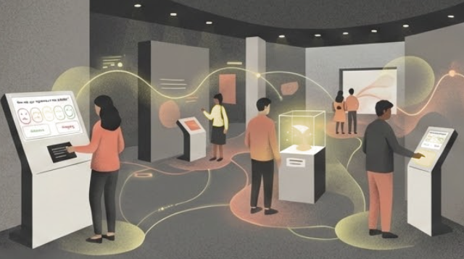
Museum Project
Liverpool Museum of Natural History
Smiley Face Survey Kiosks
Feb 2026
Notes:
LMNH's core mission is 'to provide value to the Liverpool community and the wider public'. As part of this mission, the museum regularly collects data on visitor satisfaction and wellbeing, which is then used to target exhibition development and maintenance
The kiosks have been placed at the exits of the exhibitions; visitors are asked to rate their experience of the exhibition on a five-point scale (from 😡 to 😀). Each kiosk features two other buttons: an "assistance" button, for general enquiries, and an "emergency" button for immediate support.

Slide 2
Liverpool Museum of Natural History
Contents
1.
An overview of the project and its goals
2.
Approach & Technical Decisions
3.
Challenges & Solutions
4.
Dashboard findings summary
5.
Any next steps & recommendations

Slide 3
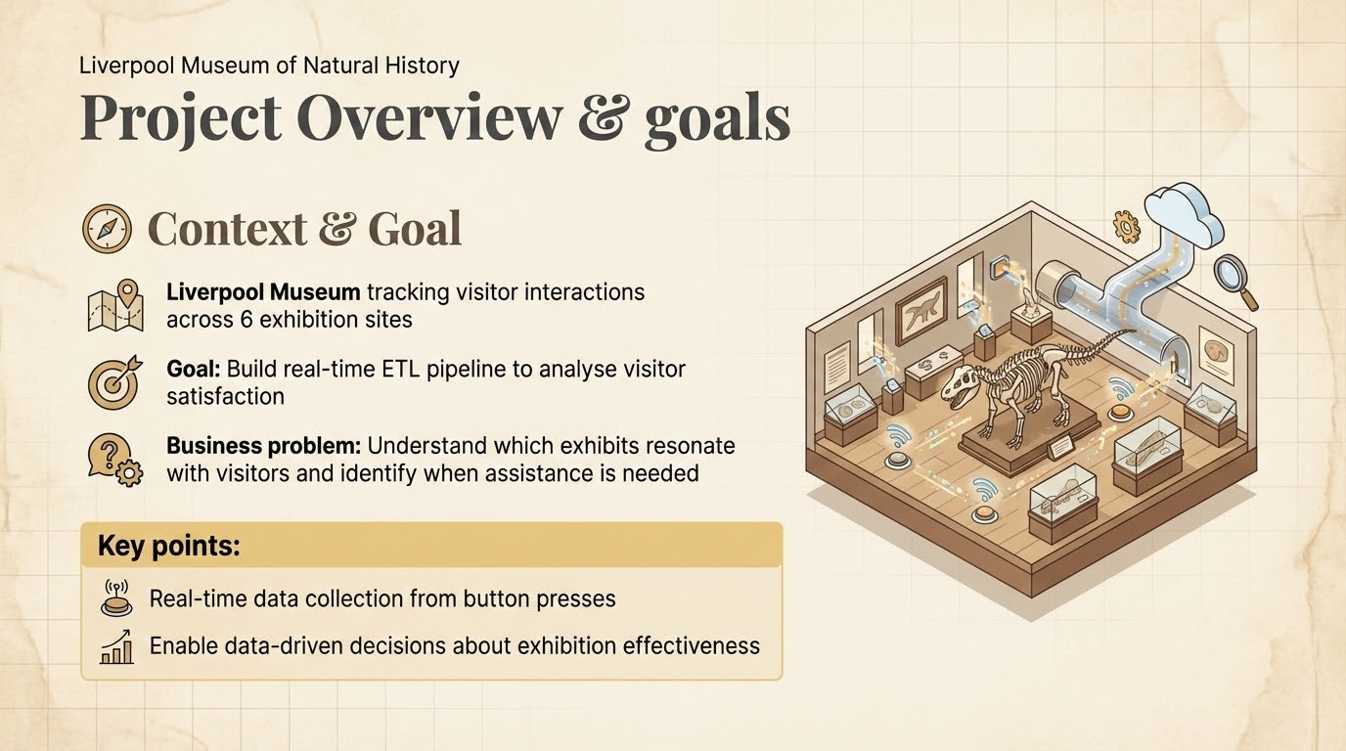
Notes:
So, let me set the context. This project was for the Liverpool History Museum, which was running a pilot study across six different exhibition sites. The museum wanted to understand how visitors were actually engaging with their exhibits - not just foot traffic, but genuine interaction and feedback.
They'd installed interactive buttons at each exhibition where visitors could do three things: First, rate their experience on a scale of 0 to 4. Second, request assistance if they had questions. And third - and this is important for accessibility - call for emergency help if needed.
The business problem was straightforward: the museum was making decisions about exhibitions based on gut feeling and anecdotal feedback. They needed data. Which exhibits were resonating with visitors? When did people need help? Were there patterns in visitor satisfaction?
My goal was to build a real-time ETL pipeline that could capture these interactions as they happened, validate the data quality, and make it immediately available for analysis. The key word here is 'real-time' - this isn't a batch process that runs overnight. Museum staff needed to see patterns as they emerged during the day, so they could respond quickly - like deploying more staff to popular exhibits or investigating why an exhibit was getting poor ratings.
Ultimately, this is about enabling data-driven decisions. Instead of guessing which exhibits work, the museum can now prove it with numbers.

Slide 4
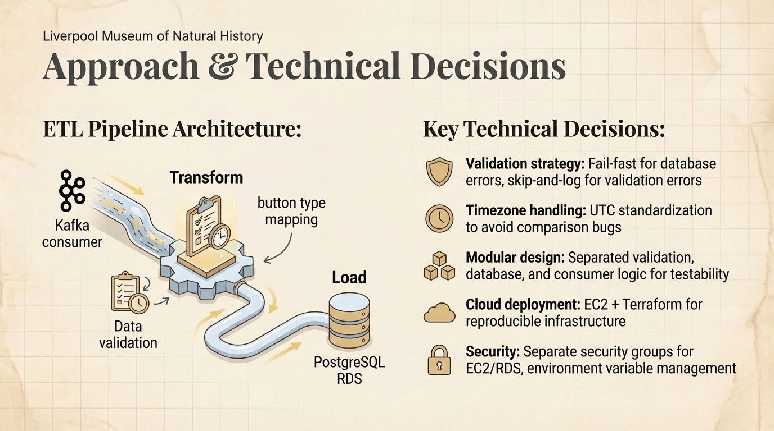
Notes:
Let me walk you through the technical approach. I built a classic ETL pipeline with three distinct stages.
Extract: Data flows in real-time from Kafka. The museum's button systems publish messages to a Kafka topic every time a visitor presses a button. I built a consumer using the Confluent Kafka Python client that continuously polls this topic - think of it like subscribing to a live feed of visitor interactions.
Transform: This is where data quality matters. Raw messages coming from Kafka needed validation before going into the database. I implemented field-level validation - checking that timestamps are legitimate and not in the future, that site IDs are within the expected range of 0 to 5 for our six sites, and that rating values make sense. I also do a transformation step where I map combinations of values to standardized button types - for example, a value of -1 with type 0 means 'assistance request', while values 0 through 4 are ratings.
Load: Validated data goes into PostgreSQL on AWS RDS. I chose PostgreSQL because it's robust, handles concurrent writes well, and provides the relational structure we need for joining interaction data with exhibition metadata.
Now, let me highlight a few key technical decisions and why I made them:
First, the validation strategy. I implemented what I call 'fail-fast for critical errors, skip-and-log for data errors.' What does that mean? If the database connection fails, the pipeline stops immediately - because continuing would mean losing data, since Kafka marks messages as consumed even if we don't store them. But if an individual message has bad data - like an invalid site ID - I log that specific message with full details and continue processing. One bad message shouldn't bring down the entire system.
Second, timezone handling. This was a subtle bug I caught early. The incoming timestamps are in UTC, but Python's datetime.now() without a timezone is naive - it uses local time. If you compare timezone-aware UTC timestamps to naive local time, you get incorrect validations. So I standardized everything to UTC to avoid those comparison bugs.
Third, modular design. I separated concerns into different modules - validation logic in one file, database operations in another, Kafka consumer logic separate again. This wasn't just for clean code - it made testing much easier. I could unit test my validation functions without needing a live Kafka cluster or database connection.
Fourth, cloud deployment with Terraform. Instead of manually clicking around the AWS console, I wrote infrastructure as code. This means the entire setup - EC2 instance, security groups, database configuration - is reproducible. If I need to rebuild this tomorrow, it's one command: terraform apply.
Finally, security. I used separate security groups for EC2 and RDS, following the principle of least privilege. The EC2 instance can talk to RDS, but external access is tightly controlled. Credentials are managed through environment variables, never hard-coded.

Slide 5
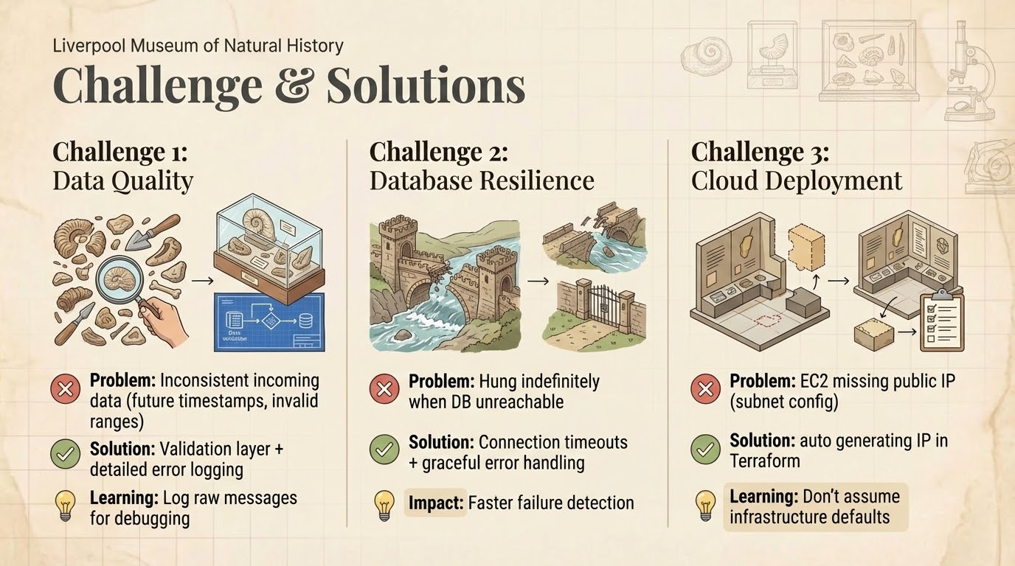
Notes:
Challenge 1: Data Quality Issues
First challenge: data quality. Messages from Kafka had inconsistent data - future timestamps, out-of-range values, missing fields.
I built a comprehensive validation layer that checks business rules, not just data types. The key learning? Log the entire raw message when validation fails. Initially I'd just log 'validation error' - useless for debugging. By logging the full message, I could spot patterns quickly - like all messages from one site failing - and identify whether it was a producer issue or my validation logic.
Challenge 2: Database Connection Resilience
Second: database connectivity. My initial code would hang indefinitely if RDS was unreachable - just sitting there waiting forever.
The fix was twofold: connection timeouts so it fails after 5 seconds instead of hanging, and smart error handling. Database down at startup? Exit immediately with a clear error. Bad data during processing? Log it and continue - one bad message shouldn't kill the pipeline. This gave me much better operational visibility
Challenge 3: AWS Deployment
Third: AWS deployment. I created my EC2 instance with Terraform, everything looked successful - but I couldn't SSH in. Turns out the subnet didn't auto-assign public IPs.
One line fix: associate_public_ip_address = true in Terraform. But the learning was bigger - don't assume infrastructure defaults. Different AWS resources have different configurations. This reinforced the value of Infrastructure as Code - once I fixed it, it's reproducible for anyone running my Terraform config.

Slide 6
Key Findings
Liverpool Museum of Natural History
Smiley Face Survey Kiosks
Feb 2026

Slide 7
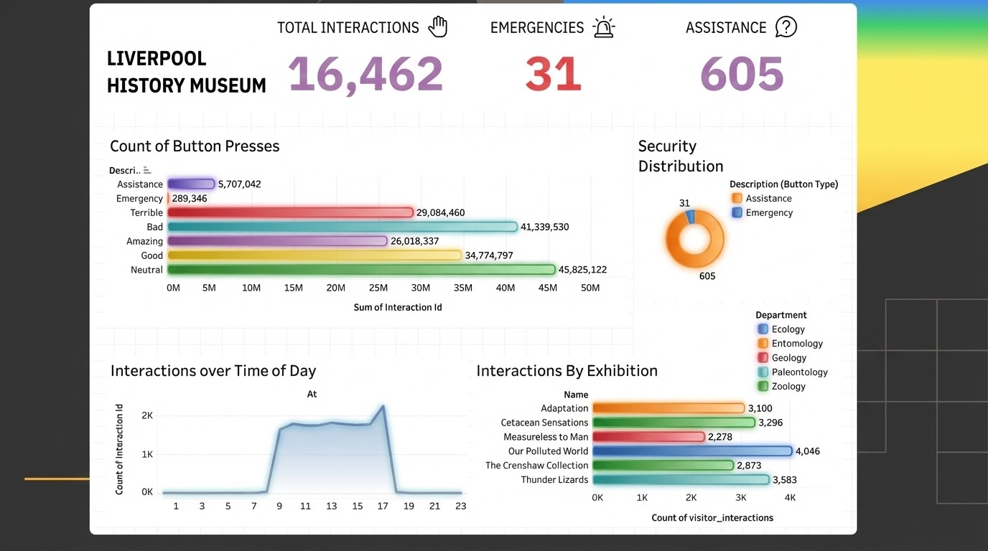
Notes:
Now let's look at what the data is actually telling us. I built this Tableau dashboard that connects directly to our RDS database, giving stakeholders real-time visibility into visitor behavior.
Starting with overall engagement: We've captured over 16,000 visitor interactions since the pipeline went live. This validates that the system is working - we're getting genuine, real-time data from all six exhibition sites.
Looking at the rating distribution - this is interesting. The data shows that neutral ratings dominate, which makes sense - most visitors have moderate opinions. But what caught my attention is that 'bad' and 'terrible' ratings combined actually outnumber the positive ratings. This is actionable intelligence for the museum - there's clearly room for improvement in the visitor experience. Whether that's clearer signage, better interactives, or repositioning exhibits - the data is telling them something needs attention.
Breaking it down by exhibition: 'Our Polluted World' leads with nearly 4,000 interactions - suggesting this topic really resonates with visitors. 'Thunder Lizards' and 'Cetacean Sensations' are close behind. Interestingly, the distribution is fairly balanced - no exhibition is being completely ignored, which is positive. But 'Measureless to Man' has noticeably lower engagement. That might warrant investigation - is it poorly positioned? Less interesting content? The data raises the question, but you'd need qualitative research to answer why.
The security features are being used too - we're seeing hundreds of assistance requests and a small number of emergency calls. This validates the dual-purpose design - these aren't just rating buttons, they're genuine safety and support tools.
Looking at temporal patterns - this chart shows interactions by hour of the day. There's a clear peak between 11 AM and 5 PM, with the sharpest spike around midday. This likely aligns with tour group schedules and lunch-time visitors. Activity drops off sharply after 7 PM, which matches closing time. For the museum, this suggests where to deploy staff - you want more people on the floor during those peak hours when visitor engagement is highest.
The key insight from all of this: the system is working, we're capturing meaningful data, and that data is immediately actionable for museum operations.

Slide 8
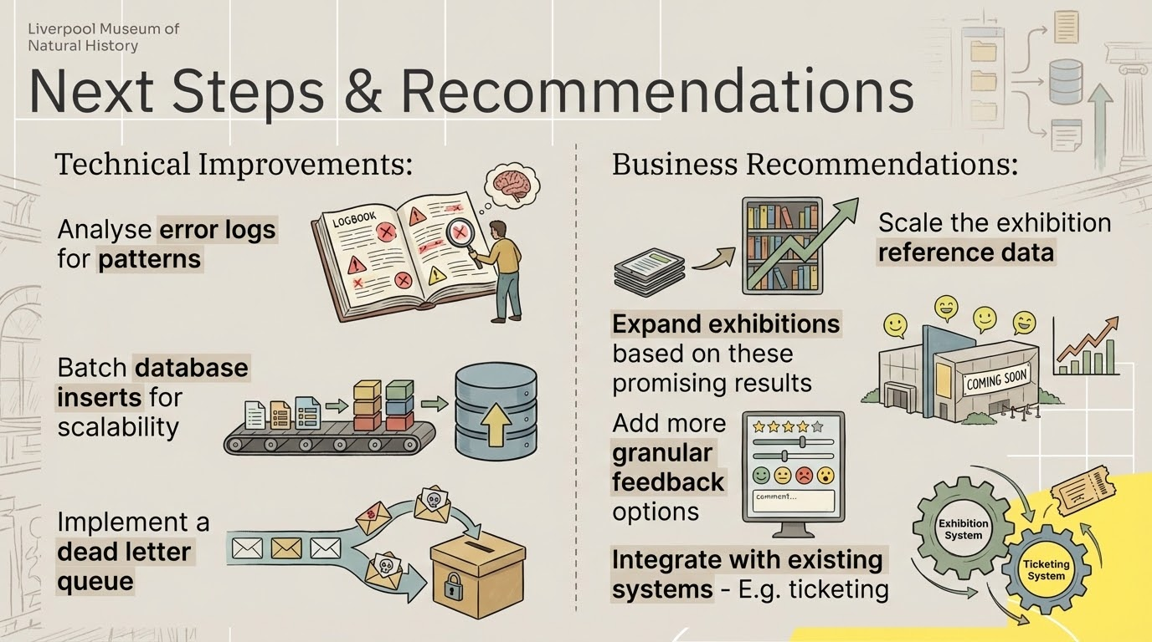
Notes:
Looking ahead, there are improvements I'd recommend in two categories: technical and business.
On the technical side:
First, analyze error logs for patterns. Right now I'm logging invalid messages, but I'm not systematically analyzing them. We could build automated monitoring that flags common error patterns - for example, if we're seeing hundreds of rapid-fire interactions from the same button in seconds, that might indicate kids spamming it, or a hardware issue where a button is stuck. Understanding why validations fail is as important as catching them.
Second, batch database inserts for scalability. Currently I'm inserting one interaction at a time. If we scale to dozens of sites, batching inserts every few seconds would significantly reduce database load and improve throughput.
Third, implement a dead letter queue. Invalid messages are currently just logged to files. A proper DLQ would let us revisit and potentially reprocess those messages if we discover the validation rules were too strict or if data quality issues get fixed upstream.
And fourth, CI/CD automation. Right now deployment means manually SSHing into EC2 and copying files. A GitHub Actions pipeline would enable automated testing and deployment with rollback capabilities if something breaks.
On the business side:
First, scale the exhibition reference data. Currently our exhibition table only has six entries for the pilot sites. As the museum expands this system, we need a process for adding new exhibitions without requiring code changes - maybe a simple admin interface or CSV upload.
Second, expand exhibitions based on these promising results. The six sites are generating clear, actionable insights - consider rolling this out to more exhibitions or even sister museums in the network.
Third, add more granular feedback options. Right now it's ratings and assistance - but what if visitors could tag why they're requesting help? 'Can't read text,' 'Want more information,' 'Technical issue' - that would help staff respond more effectively.
And finally, integrate with existing systems. Combine this interaction data with ticketing systems, foot traffic counters, and demographic data to build a complete picture of visitor behavior. For example, do school groups interact differently than adult visitors? Do weekend ratings differ from weekdays?
Thank you - I'm happy to take any questions."

